Slide 1

ENHANCING SEARCH DATA ANALYSIS A MACHINE LEARNING APPROACH FOR ONLINE SEARCH DATA DEMAND

Slide 2

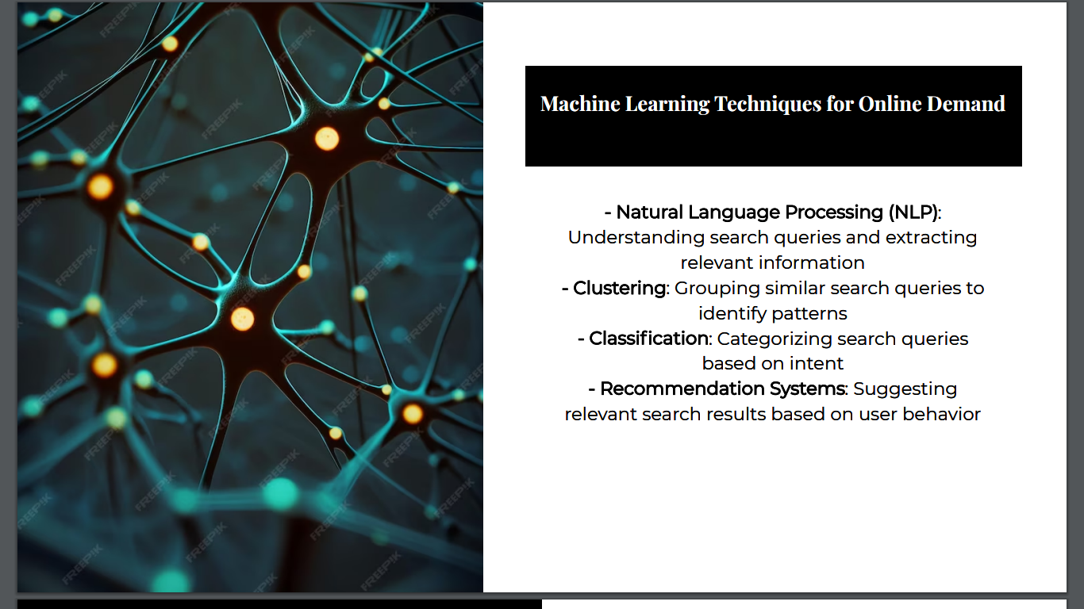

Slide 3


Slide 4

CODING
RANDOM DATA:
import pandas as pd
df = pd.DataFrame({
'search_term': ['iPhone 14', 'Samsung Galaxy S23', 'Google Pixel 7', 'MacBook Air M2', 'AirPods Pro 2', 'PlayStation 5', 'Xbox Series X', 'Nintendo Switch OLED', 'LEGO Star Wars: The Skywalker Saga', 'Elden Ring', 'God of War Ragnarök'],
'search_volume': [100000, 90000, 80000, 70000, 60000, 50000, 40000, 30000, 20000, 10000, 5000]
})
df.head()
READ ING DATA SET
import pandas as pd
# Load the dataset
df = pd.read_csv('dataset.csv')

Slide 5
MAIN CODING
import pandas as pd
from sklearn.model_selection import train_test_split
from sklearn.preprocessing import StandardScaler
# Load the dataset
df = pd.read_csv('dataset.csv')
# Identify and handle missing values
df.dropna(inplace=True)
# Encode categorical data
df['product_category'] = pd.get_dummies(df['product_category'])
# Split the dataset into training and test sets
X_train, X_test, y_train, y_test = train_test_split(df.drop('demand', axis=1), df['demand'], test_size=0.25)
# Scale the features
scaler = StandardScaler()
X_train = scaler.fit_transform(X_train)
X_test = scaler.transform(X_test)
# Save the preprocessed datasets
X_train.to_pickle('X_train.pkl')
X_test.to_pickle('X_test.pkl')
y_train.to_pickle('y_train.pkl')
y_test.to_pickle('y_test.pkl')
# Split the dataset into training and test sets
X_train, X_test, y_train, y_test = train_test_split(df.drop('demand', axis=1), df['demand'], test_size=0.25)
# Scale the features
scaler = StandardScaler()
X_train = scaler.fit_transform(X_train)
X_test = scaler.transform(X_test)
# Save the preprocessed datasets
X_train.to_pickle('X_train.pkl')
X_test.to_pickle('X_test.pkl')
y_train.to_pickle('y_train.pkl')
y_test.to_pickle('y_test.pkl')
# Split the dataset into training and test sets
X_train, X_test, y_train, y_test = train_test_split(df.drop('demand', axis=1), df['demand'], test_size=0.25)
# Scale the features
scaler = StandardScaler()
X_train = scaler.fit_transform(X_train)
X_test = scaler.transform(X_test)
# Save the preprocessed datasets
X_train.to_pickle('X_train.pkl')
X_test.to_pickle('X_test.pkl')
y_train.to_pickle('y_train.pkl')
y_test.to_pickle('y_test.pkl')

Slide 6
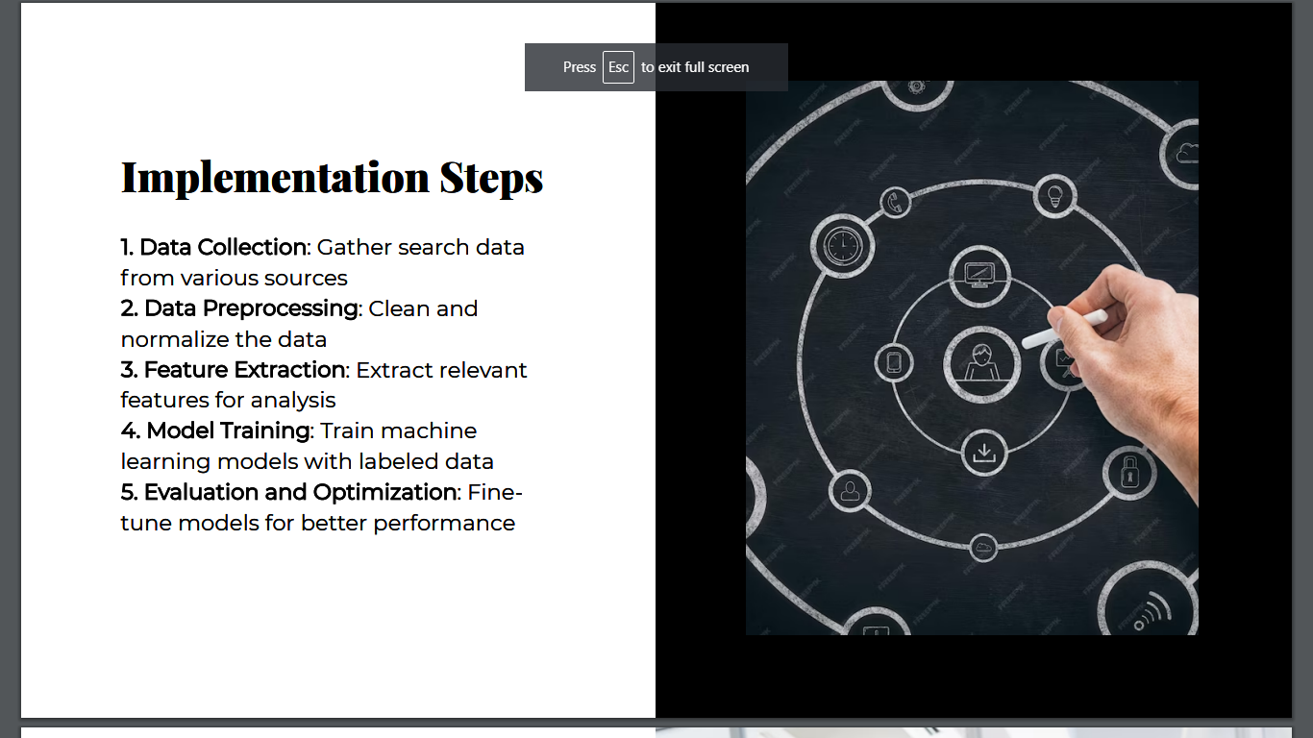

Slide 7
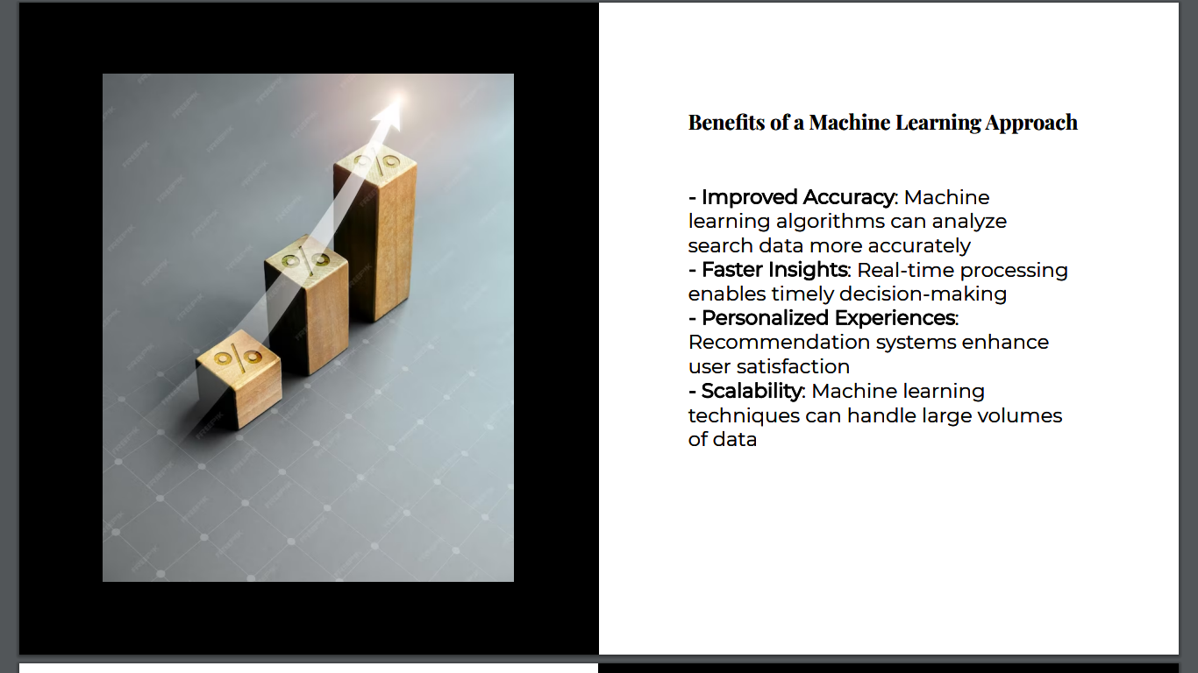

Slide 8
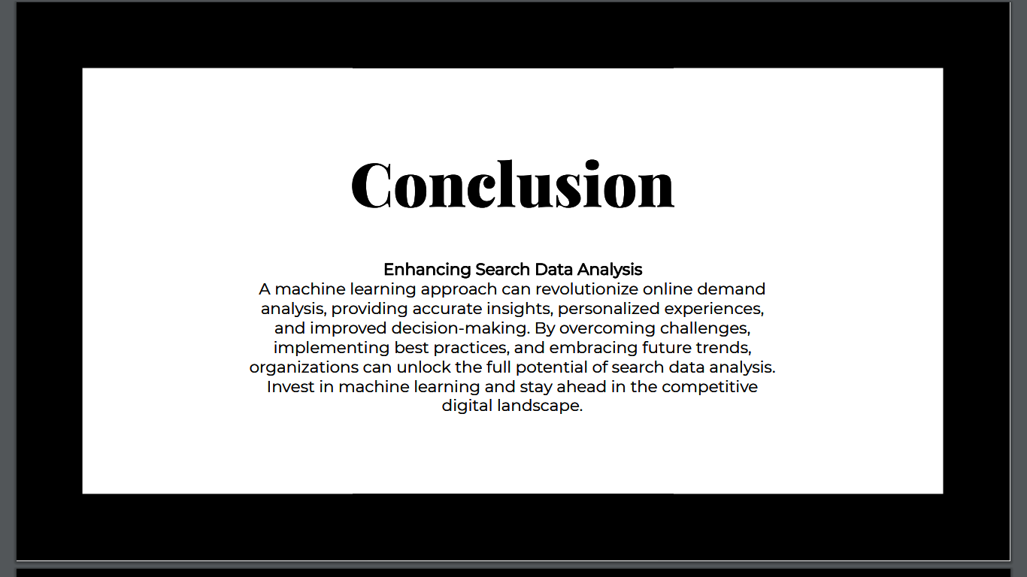

Slide 9
THANKYOU

